Slide 1

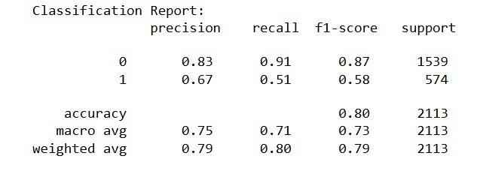
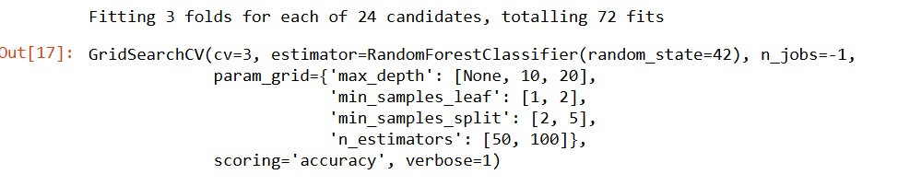
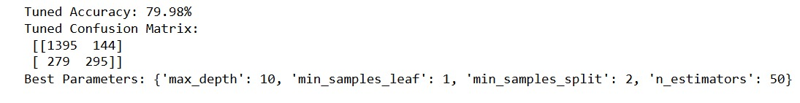
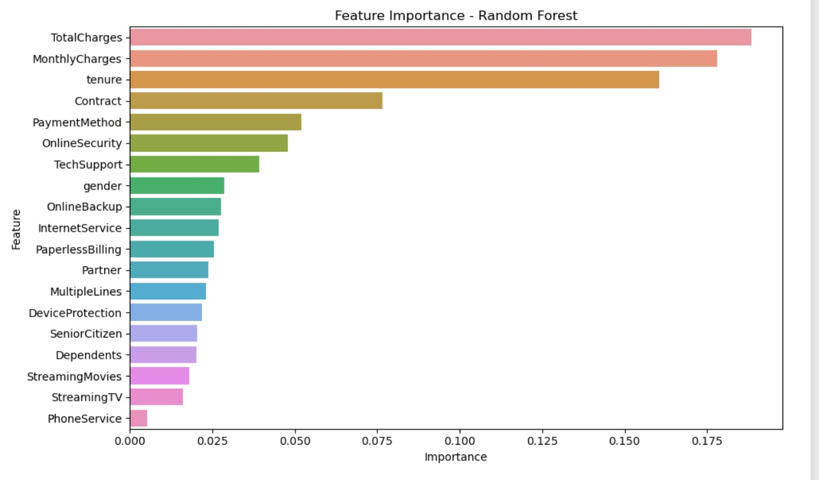
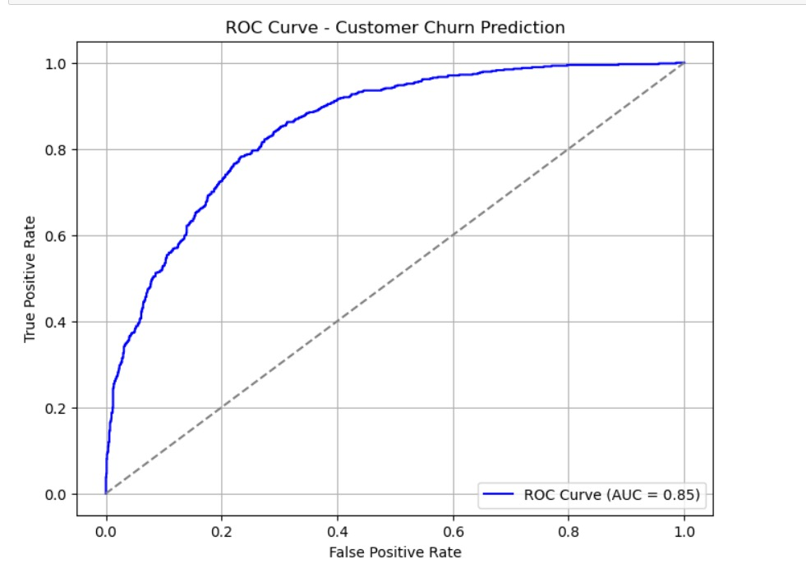
Predictive Analytics for Business Decision-Making: Unleashing the Power of Data-driven Insights
Names: Yash Patel, Saumil Trivedi, Akshar Barot, Bibek Kandel, Jayanth Kumar
Advisor: Ali M. Baker, Ph.D.
College of Engineering, Business, and Education
Ernest C. Trefz School of Business
University of Bridgeport, Bridgeport, CT
Abstract
Methodology
Customer attrition presents a considerable challenge for organizations, directly affecting revenue and overall growth. This research employs predictive analytics through machine learning techniques to examine customer behaviors and assess the likelihood of churn. The Customer Churn Prediction dataset is subjected to data preprocessing, feature selection, and model assessment. Machine learning classification methods, including Random Forest, are evaluated based on accuracy, precision, recall, and AUC-ROC metrics. The results indicate that the “Random Forest model” achieves the highest accuracy at “79.98%”, with key factors influencing churn identified as contract type and monthly fees. These insights empower companies to formulate “proactive retention strategies”, mitigate churn, and improve customer satisfaction.
We employed a supervised machine learning method using Python to forecast customer churn. We preprocessed the dataset and divided the data into training and test sets. We employed a Random Forest Classifier as our predictive model since it is stable and simple to interpret. To determine the optimal hyper parameters, we employed Grid SearchCV with 3-fold cross-validation, and the following parameters were found: n_estimators = 50, max_depth = 10, min_samples_split = 2, and min_samples_leaf = 1. It was tested on the training subset and then tested on the test subset for various measures of performance like accuracy, confusion matrix, ROC-AUC measure, and overall classification report. We further demonstrated feature importance to learn which were dominant drivers influencing churn predictions.
.
Literature Review
Results
Churn prediction has emerged as a critical focus within business analytics, as it enables organizations to retain valuable customers by recognizing patterns that are likely to lead to attrition. Investigations in this domain combine machine learning, statistical modeling, and decision support systems to improve predictive accuracy.
Numerous studies have investigated machine learning methodologies for forecasting customer churn. Manzoor et al. (2024) conducted a comprehensive review of machine learning techniques, focusing particularly on feature selection and the interpretability of models. Burez and Van den Poel (2009) examined the issue of class imbalance in churn data, demonstrating that the application of resampling techniques can significantly enhance predictive accuracy. Lemmens and Gupta (2020) introduced a profit-maximization strategy centered on customer lifetime value (CLV) to facilitate optimal resource distribution. Gerber et al. (2020) utilized Random Forest for predicting churn in the health insurance sector, highlighting the effects of censoring mechanisms. A study published in ScienceDirect (2025) evaluated ensemble models, including Random Forest and XGBoost, revealing notable improvements in predictive performance. Collectively, these studies illustrate the potential of machine learning to enhance churn prediction and customer retention across various industries.
The top-performing Random Forest model had an overall test set accuracy of 79.98%. From the confusion matrix, there were high predictive abilities found in 1,395 true negatives and 295 true positives and 144 false positives and 279 false negatives. This means that the model is good at flagging customers that can be expected to stay but slightly less good at identifying all those which can potentially churn. The classification report concurs, with 0.83 precision and 0.91 recall for the non-churning customers, compared to 0.67 precision and 0.51 recall for the churners. The f1-scores are 0.87 for the non-churners and 0.58 for the churners, suggesting a more consonant balance between precision and recall for the large class. The macro average f1-score was 0.73 and the weighted average was 0.79, further establishing the model's consistent performance in classes. The AUC score of 0.85, evident from the ROC curve, establishes a highly good discrimination capacity between churn and non-churn outcomes. Feature importance analysis also pinpointed TotalCharges, MonthlyCharges, and tenure as the important variables that drive the model, stressing the significance of customer spend behavior and service duration in churn prediction.
Conclusions
This study proves the capability of machine learning in forecasting customer churn, presenting valuable results for strategic retention activities. The high accuracy and high AUC value of the model affirm its reliability, especially in determining customers likely to remain. However, the lesser recall rate (0.51) for churned customers emphasizes some of the issues in entirely recognizing all likely churners, which can be addressed by adding other behavioral or service interaction variables in future models. Organizations can apply these insights to implement data-driven initiatives with a view to reducing churn. Future research may explore other algorithms, cost-sensitive learning, or ensemble techniques to improve predictive accuracy, particularly for the churn category.
References
AWAIS MANZOOR,M. ATIF QURESHI, ETAIN KIDNEY , AND LUCA LONGO(2024). A Review on Machine Learning Methods for Customer Churn Prediction and Recommendations for Business Practitioners. Volume: 12, 70434 - 70463.
Burez, J., & Van den Poel, D. (2009). Handling class imbalance in customer churn prediction. European Journal of Operational Research, 197(1), 402-411.
Lemmens, A., & Gupta, S. (2020). Managing churn to maximize profits. Management Science, 66(8), 3421-3439.
Guillaume Gerbera Forsides, Paris, France,Yohann Le Faou,Olivier Lopez &Michael Trupin(2020). The Impact of Churn on Client Value in Health Insurance, Evaluation Using a Random Forest Under Various Censoring Mechanisms. Journal of the American Statistical Association, 116, 2021 , 2053-2064.
Enhancing customer retention with machine learning: A comparative analysis of ensemble models for accurate churn prediction(2025). ScienceDirect, Volume 5, Issue 1, 100331
https://ieeexplore.ieee.org/document/10724574.
* If you are a non-UB poster submitter, please insert the appropriate logo, school institution name, and location in Connecticut.

